Slide 1
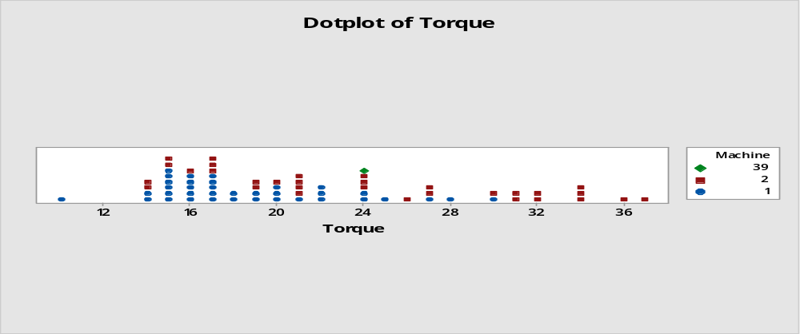

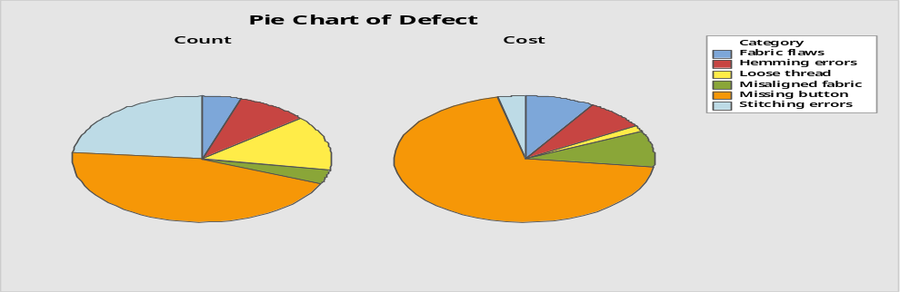
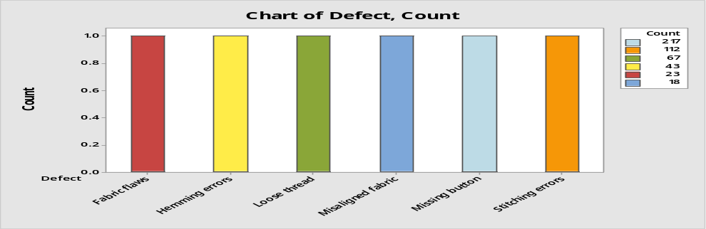
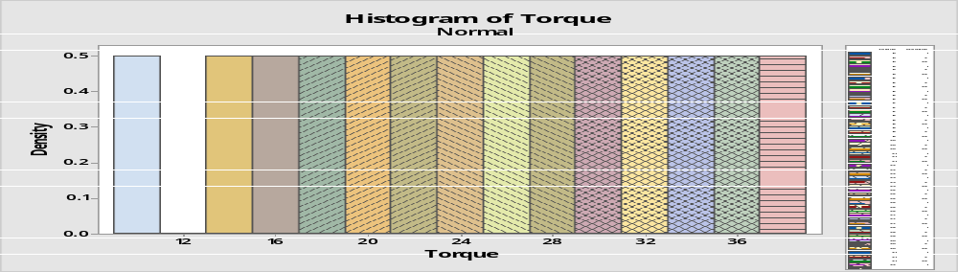
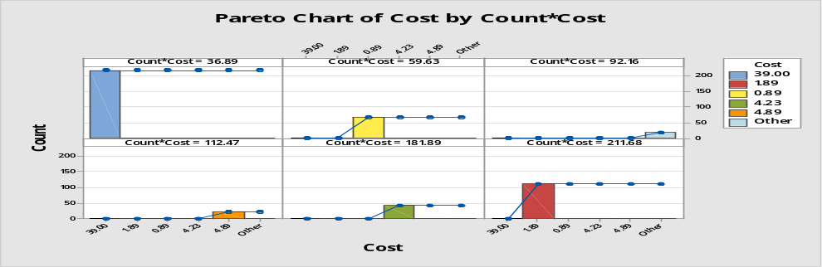
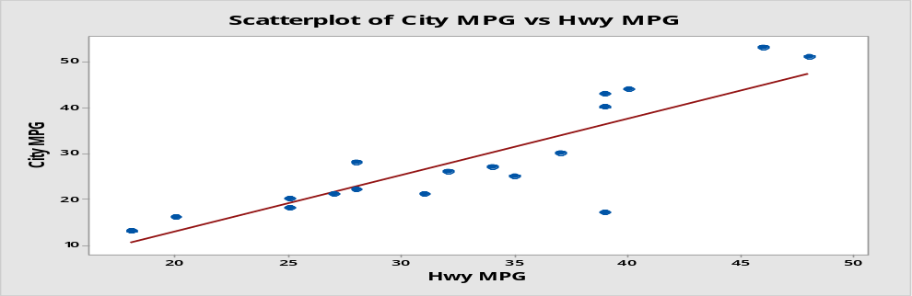
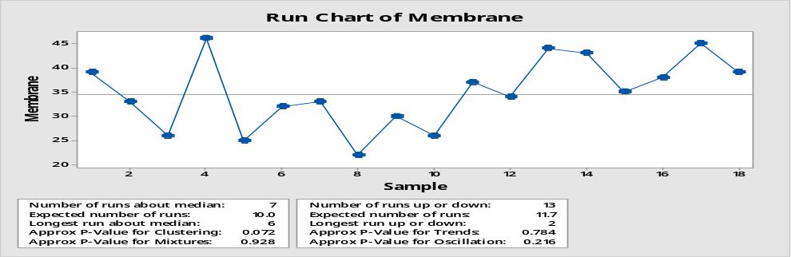
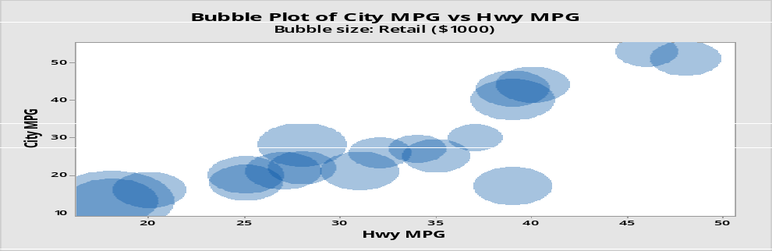
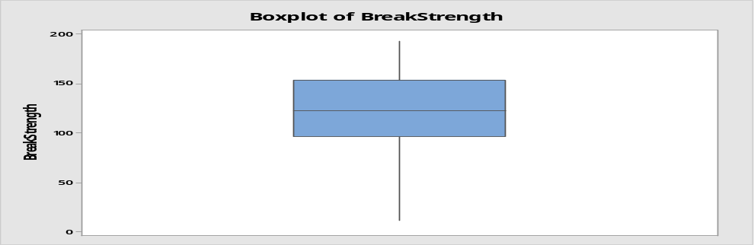
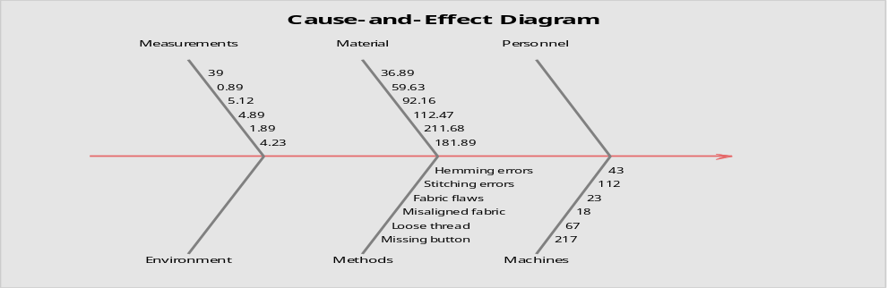
The Purpose of Minitab Minitab, originally intended as a tool for teaching statistics, is a general-purpose statistical software package designed for easy interactive use. 1)Familiar worksheets make it easy to type,load, copy and paste data 2)Menus are organized to complement leading textbooks. 3)Clean,straightforward dialogues are easy to complete. 4)All analyses are archived for easy review.
The Purpose of Minitab Minitab, originally intended as a tool for teaching statistics, is a general-purpose statistical software package designed for easy interactive use. 1)Familiar worksheets make it easy to type,load, copy and paste data 2)Menus are organized to complement leading textbooks. 3)Clean,straightforward dialogues are easy to complete. 4)All analyses are archived for easy review.
Exploratory Data Analysis Using Minitab
Submitted By : Azmin Ahmed Antho
Industrial & Production Engineering
ID NO: 201636039
PIE CHART
BAR CHART
HISTOGRAM
The Purpose of Minitab: Minitab, originally intended as a tool for teaching statistics, is a general-purpose statistical software package designed for easy interactive use. 1)Familiar worksheets make it easy to type ,load, copy and paste data 2)Menus are organized to complement leading textbooks. 3)Clean, straight forward dialogues are easy to complete. 4)All analyses are archived for easy review.
PARETO CHART
SCATTERPLOT
Summary: In this poster, using Minitab to plot some data and find different types of graph. Here making 10 types of graph using different data. The graphs are such as histogram, pie chart, Bar chart etc. In the Minitab there are different tool. Mainly using some of these as Stat ,Graph ,Calc etc.. Stat: By using this tool bar we can take different types of graph such as ANOVA, Quality Tools etc. Help: It is used to get knowledge if any data can't find easily
RUN CHART
BUBBLE PLOT
BOX PLOT
CAUSE & EFFECT DIAGRAM

